Slide 1
CS30500: Introduction to Software Engineering
Spring 2025
Chapter 3. Agility and Process 2/2
Prof. In-Young Ko
School of Computing

Slide 2
Last Class
Agility
Popular agile methods
Scrum
Extreme Programming (XP)
Kanban

Slide 3
Today’s Plan
Popular agile methods
Scrum
Extreme Programming (XP)
Kanban
Comparison among process models
DevOps

Slide 4
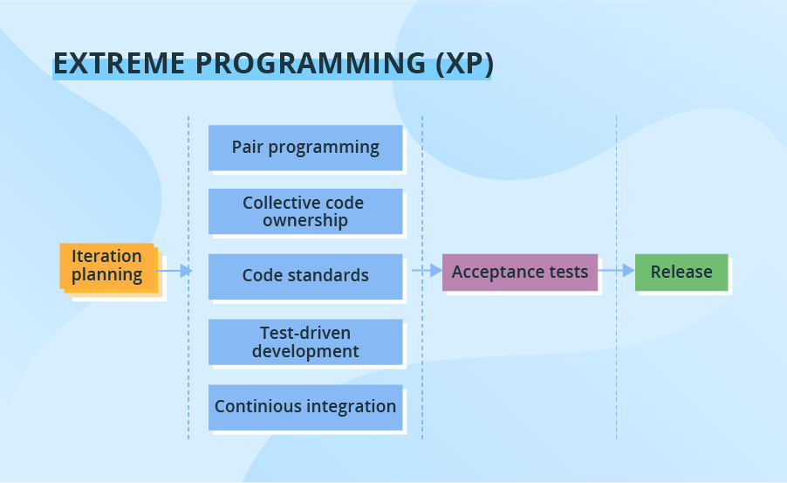
What is Extreme Programming (XP)?
An iterative process with a set of rules and practices to deal with changing requirements
Developed by Kent Beck in the late 1990s
An iteration
An iteration of framework activities (planning, design, coding and testing)
1-2 weeks long
Requirement changes can be made even after an iteration is launched
Use the following practices:
Pair programming
Test-driven development and test automation
Continuous integration (CI)
Small releases
Simple software design
Prescribes to follow the coding standards
[Shi19]

Slide 5
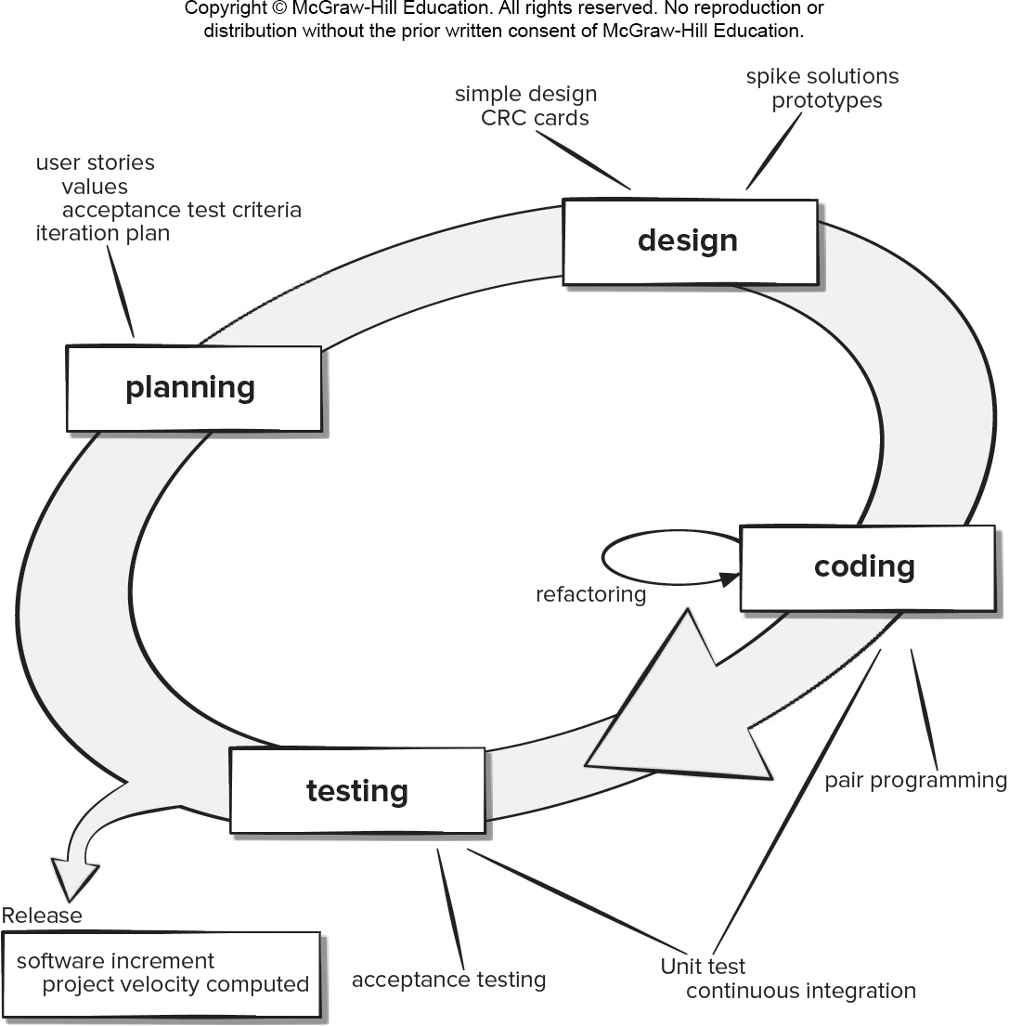
XP Activities (1/2)
[PrMa20 ]
Planning
Listening customer requirements and making user stories
Prioritizing the user stories by the customers
Assessing the cost (development weeks) of each story by the team
Group stories into the next software increment (release) by the team and the customers
Design
Use CRC (class-responsibility-collaborator) cards to identify and organize object-oriented classes
Develop an operational prototype to understand and solve a problem → refactoring (modifying and optimizing) the code

Slide 6
XP Activities (2/2)
[PrMa20 ]
Coding
Develop firstly a series of unit tests for testing each of the stories in the release → helps to understand what to implement
Pair programming – two people work together to implement each story and review code
Continuous integration of unit code
Testing
Automated unit testing for regression testing
Acceptance testing to test overall system features
Pair programming and collaboration example: https://www.youtube.com/watch?v=tPxGoE43r_k

Slide 7
User Stories – Kent Beck
Basic unit of requirements in agile methodologies
Represent a feature desired by the customer
Written by the customer on index cards
Use cases can be derived from them
User Story Components:
Title – written in a present tense, active voice
Acceptance test: a method to test the story
Priority
Story points: estimated time to implement
Description – written in one to three sentences
Phillip A. Laplante, Requirements Engineering for Software and Systems, 3rd Ed., CRC Press, 2018
https://www.c-sharpcorner.com/article/what-is-user-story-in-agile-scrum/

Slide 8
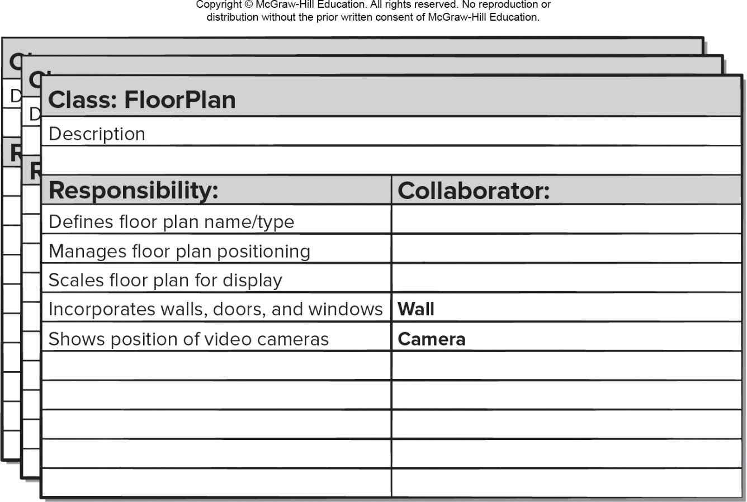
CRC Modeling
Class-responsibility-collaborator (CRC) modeling provides a simple means for identifying and organizing the classes that are relevant to system or product requirements
A CRC model is a collection of standard index cards that represent classes
The cards are divided into three sections:
Along the top of the card you write the name of the class
List the class responsibilities on the left
List the collaborators on the right
[PrMa20 ]

Slide 9
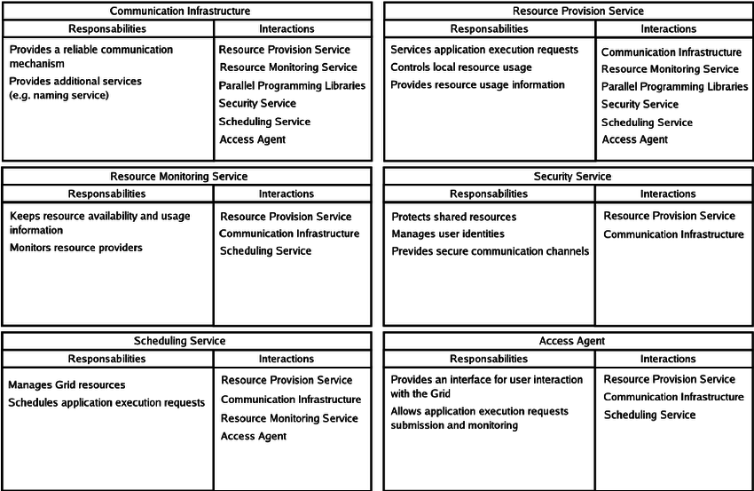
CRC Card Example
Camargo, Raphael & Goldchleger, Andrei & Carneiro, M & Kon, Fabio. (2004). Grid: An Architectural Pattern.

Slide 10
Pros and Cons of XP
Pros
Emphasizes customer involvement
Establishes rational plans and schedules
High developer commitment to the project
Reduced likelihood of product rejection
Cons
Requires frequent meetings about increasing costs
Allows for excessive changes
Depends on highly skilled team members
[PrMa20 ]

Slide 11
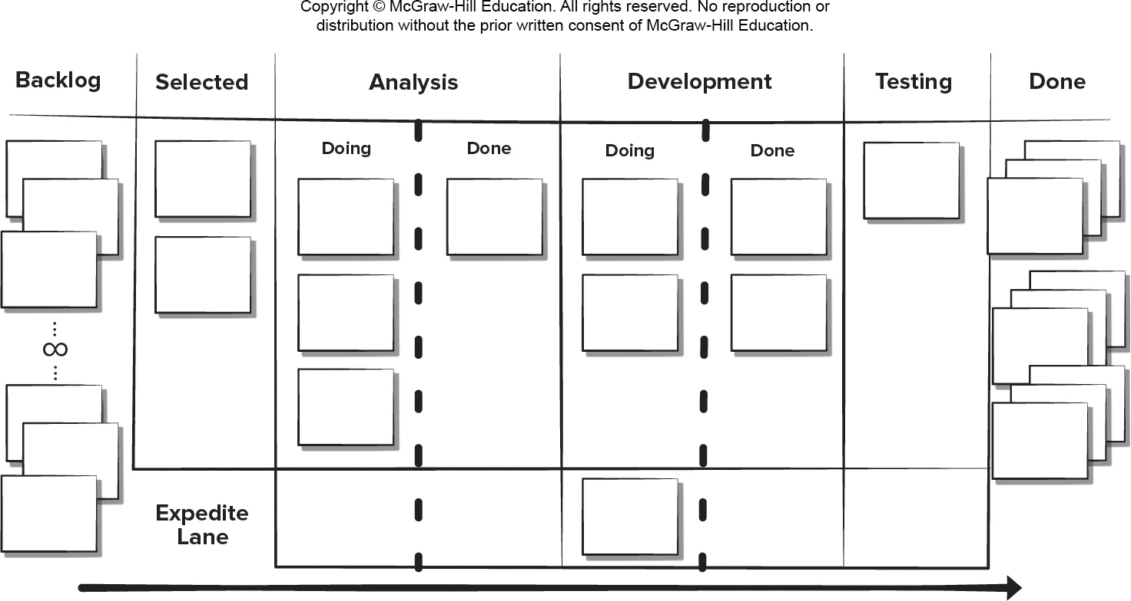
Kanban
Methodology for managing changes and service delivery
By plan visualization, ongoing communication with customers, and identifying urgent tasks accurately
Originated at Toyota and adapted to software development by David Anderson in 2010
Daily standup meeting & weekly retrospective meeting
Can easily be combined with other agile practices
[PrMa20 ]

Slide 12

Kanban Practices
Visualizing workflow using a Kanban board – a clear representation of all project activities, responsible persons, and progress
Limiting the amount of work in progress (WIP) at any given time
Managing workflow to reduce waste by understanding the current value flow
Making process policies explicit and the criteria used to define “done”
[PrMa20 ]
Focusing on continuous improvement by creating feedback loops where changes are introduced
Make process changes collaboratively and involve all stakeholders as needed

Slide 13
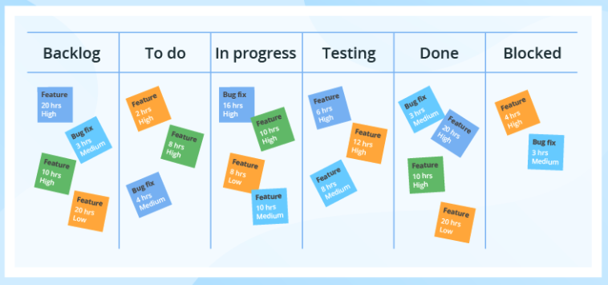
Pros and Cons of Kanban
Pros
Lower budget and time requirements
Allows early product delivery
Process policies written down
Continuous process improvement
Cons
Team collaboration skills determine success
Poor business analysis can doom the project
Flexibility can cause developers to lose focus
Developer reluctance to use measurement
[Shi19]
[PrMa20 ]

Slide 14
DevOps

Slide 15
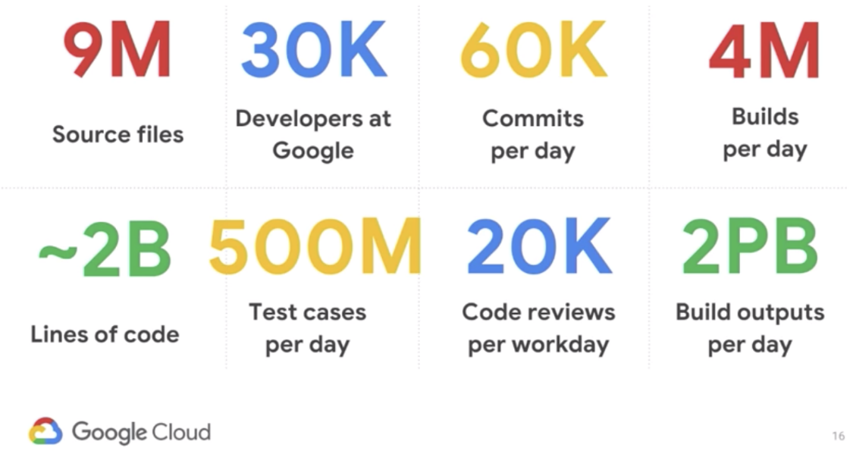
Challenge of Software Delivery
[Ama17] “Practicing Continuous Integration and Continuous Delivery on AWS”, AWS White paper, Amazon Web Services, Inc., 2017
Effectively dealing with rapidly changing competitive landscapes
Meeting and managing evolving security requirements, and performance scalability
Bridging the gap between operations stability and rapid feature development
Many (thousands of) independent software teams should be able to work in parallel to deliver software quickly, securely, and reliably
https://jaxenter.com/cloud-native-devops-160928.html

Slide 16
DevOps
“DevOps is a set of practices intended to reduce the time between committing a change to a system and the change being placed into normal production, while ensuring high quality.” [Bass et al.]
TEST
MONITOR
BUILD
OPERATE
Development
Operations
DEVELOP
DEPLOY
REQUIREMENTS
RELEASE

Slide 17
DevOps Practices
Developed by Patrick DeBios in 2009
Consider Ops requirements in software development – e.g., logging and monitoring requirements
Shorten the bug-fixing time (the time between error detection and repair)
Enforce the deployment process and trace the history of software deployment
Use continuous deployment – shorten the time between code commit and deployment & use of automated tests
Develop infrastructure code – e.g., deployment scripts
[BWZ15] Len Bass, Ingo M. Weber, Liming Zhu, DevOps: A Software Architect’s Perspective, Addison-Wesley, 2015

Slide 18

DevOps Teams
Relatively small teams – “two pizza rule” (Jeff Bezos, Amazon)
Advantages of small teams
Make decisions quickly
Work together in a coherent unit in which everyone understands common goals
Express opinions and ideas easily
Team roles
Team lead – project management
Team members – developers
Service owner – responsible for outside coordination (communicate with stakeholders)
Reliability engineer – monitor the service after deployment & diagnose, mitigate and repair problems
Gatekeeper (release coordinator) – make decision on deploying services based on test results and with communicating with other roles
https://entrepreneurshandbook.co/lessons-from-the-billionaire-ceo-who-invented-the-2-pizza-rule-a4b949989c03
[BWZ15] Len Bass, Ingo M. Weber, Liming Zhu, DevOps: A Software Architect’s Perspective, Addison-Wesley, 2015

Slide 19
Building and Testing in DevOps
Team members can work on different versions concurrently
Work is not lost if a team member leaves the team
Code can be easily tested
Code can be easily integrated with the code produced by other members (other teams)
An integrated version can be easily deployed into various environments (e.g., testing, staging, and production)
An integrated version can be tested without affecting the production version
A recently deployed version can be closely supervised
Older versions are available in case a problem
Code can be rolled back in the case of a problem
Deployment pipeline:
[BWZ15] Len Bass, Ingo M. Weber, Liming Zhu, DevOps: A Software Architect’s Perspective, Addison-Wesley, 2015
Notes:
UAT: User Acceptance Test

Slide 20
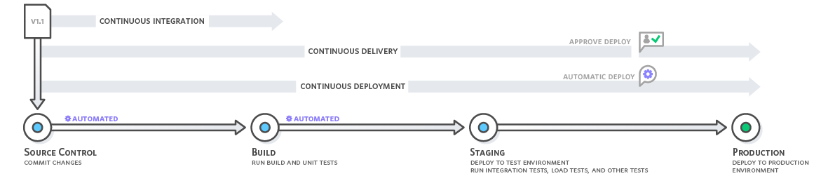
Continuous Integration, Delivery & Deployment
[Ama17] “Practicing Continuous Integration and Continuous Delivery on AWS”, AWS White paper, Amazon Web Services, Inc., 2017
Continuous Integration (CI) – automate the triggers between one phase and the next, up to integration tests
Continuous Delivery (CD) – automate the triggers as far as the staging system (UAT / staging / performance tests)
Continuous Deployment – automate the entire deployment pipeline (i.e., up to the deployment into the production system)
Once a service is deployed into production it is closely monitored for a period and then it is promoted into normal production
[BWZ15] Len Bass, Ingo M. Weber, Liming Zhu, DevOps: A Software Architect’s Perspective, Addison-Wesley, 2015

Slide 21
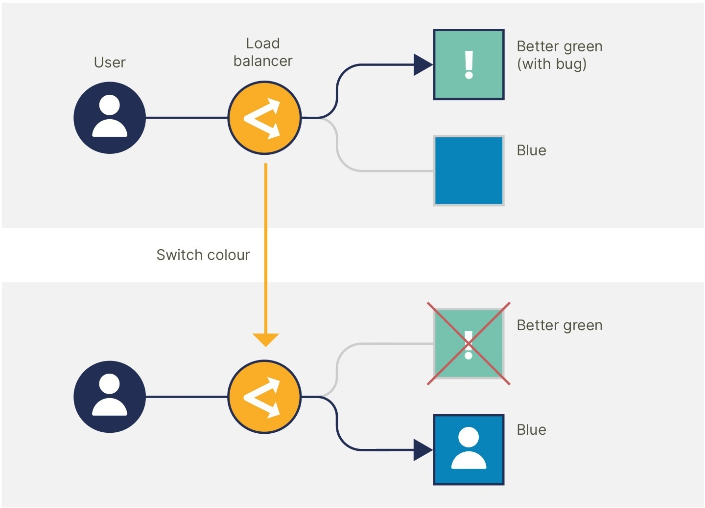
Software Architecture for DevOps
[BWZ15] Len Bass, Ingo M. Weber, Liming Zhu, DevOps: A Software Architect’s Perspective, Addison-Wesley, 2015
Architectural refactoring may be necessary to get the full benefit of DevOps
Architectural requirements for DevOps:
Components should be small enough to be developed by small teams
Components should be compatible with other components with which they interact
Components should be independently deployable
Rolling back a deployment (in the event of errors) should be possible
https://gearset.com/careers/blog/instant-rollbacks-without-interruption-how-we-ship-new-versions-of-gearset-every-day/

Slide 22
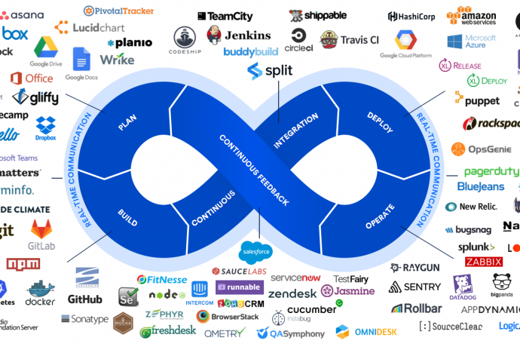
DevOps Tools
https://www.osolabs.com/blog/devops-tools-of-the-trade/

Slide 23
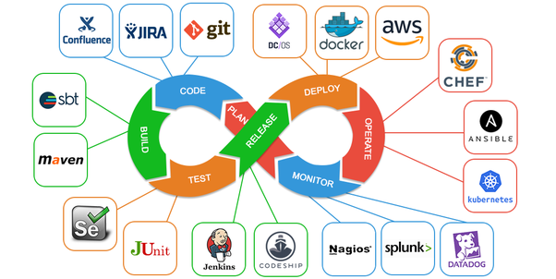
Popular DevOps Tools
Git – version control & collaboration
Jira – project management & issue tracking
Maven – automated build and management
Selenium – automated testing
SonarQube – automated code quality management for CI
Docker – automated deployment
Jenkins – continuous integration (various plug-ins for building, testing & deploying)
Chef – configuration management (infrastructure as code)
Kubernetes – automated deployment, scaling & management
Splunk – monitoring & visualization
…
https://www.osolabs.com/blog/devops-tools-of-the-trade/

Slide 24
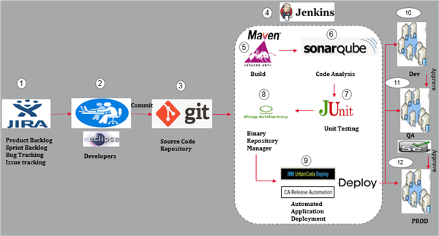
A DevOps Tool Chain
https://www.softwaretestinghelp.com/devops-tools/

Slide 25
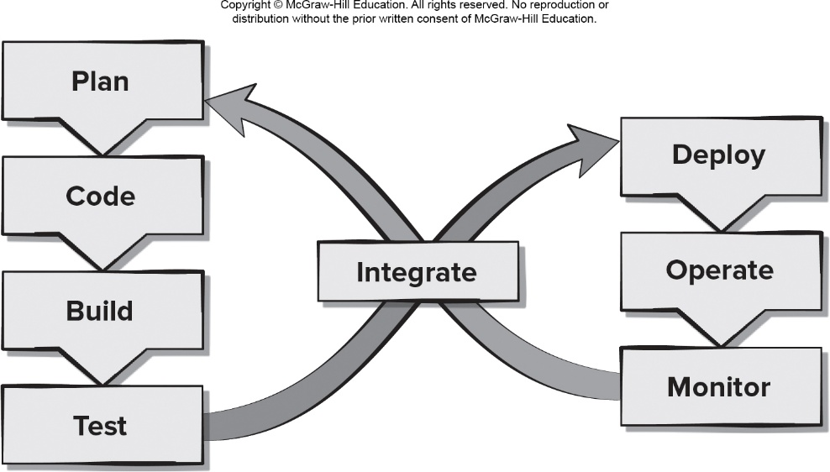
Pros and Cons of DevOps
Pros
Reduced time to code deployment
Team has developers and operations staff
Team has end-to-end project ownership
Proactive monitoring of deployed product
Cons
Pressure to work on both old and new code
Heavy reliance on automated tools to be effective
Deployment may affect the production environment
Requires an expert development team
[PrMa20 ]

